Slide 1
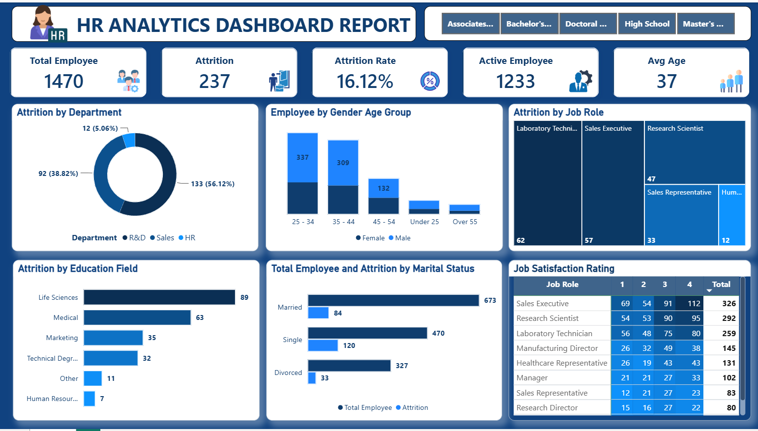

Slide 2
Business Problem
The HR department wants to analyze employee workforce data to understand attrition trends, workforce demographics, employee satisfaction, and departmental performance.
The objective is to identify the key factors contributing to employee attrition and improve employee retention through data-driven decision-making.

Slide 3
Business Requirements
The HR department requires an interactive dashboard that enables stakeholders to:
Monitor overall workforce strength and active employees.
Track employee attrition and attrition rate.
Analyze attrition across different departments, education fields, age groups, and genders.
Evaluate employee distribution by age group and educational qualification.
Measure job satisfaction across different job roles.
Filter the dashboard based on employee education level.
Identify high-risk employee groups to support retention strategies and workforce planning.

Slide 4
Key Performance Indicators (KPIs)
The dashboard should provide the following KPIs:
Overall Employees – Total number of employees in the organization.
Attrition – Total number of employees who left the organization.
Attrition Rate (%) – Percentage of employees who left the organization.
Active Employees – Total number of currently active employees.
Average Employee Age – Average age of the workforce.
These KPIs provide a quick overview of workforce health, employee retention, and organizational stability.

Slide 5
Dashboard Visualization Requirements
The dashboard should include the following visualizations:
Department-wise Attrition (Pie Chart) – Compare employee attrition across different departments.
Employees by Age Group (Stacked Column Chart) – Analyze workforce distribution by age group and gender.
Job Satisfaction Rating (Matrix/Table) – Evaluate job satisfaction scores across different job roles.
Education Field-wise Attrition (Bar Chart) – Identify education fields with the highest employee attrition.
Attrition Rate by Gender and Age Group (Donut Charts) – Compare attrition across gender within different age groups.
Education Level Slicer – Filter the dashboard based on employee educational qualification.
These visualizations help stakeholders understand sales trends, regional performance, customer channels, and product demand, enabling informed business decisions.

